Slide 1
Unit 3: Political Beliefs and Behaviors
Lesson 6: Money, Media & Politics
Notes:
1

Slide 2
Preview
Consider possible answers to the following Essential Question:
How do money and the media influence politics in the United States?
Notes:
2

Slide 3
Preview
What dangers are created in American politics by the fact much money is needed to run for public office?
Notes:
3

Slide 4
Preview
Create a spoke diagram identifying the various sources of campaign funding.
Temporary
Groups
Fat Cats
Small Donors
Sources of Funding
PACs
Candidates
Fund- Raisers
Notes:
4

Slide 5
Preview
Analyze and make two observations related to the data in the table.
Total Campaign Spending, 1960 - 2004
Year | Total | Per Voter | Year | Total | Per Voter
1960 | $175 M | $2.54 | 1984 | $1.8 B | $19.42
1964 | $200 M | $2.83 | 1988 | $2.7 B | $29.48
1968 | $300 M | $4.10 | 1992 | $3.2 B | $30.65
1972 | $425 M | $5.47 | 1996 | $4.0 B | $41.45
1976 | $540 M | $6.62 | 2000 | $5.1 B | $48.39
1980 | $1.2 B | $13.87 | 2004 | $6.0 B | $49.92
Notes:
5

Slide 6
Preview
Define the terms.
hard money: money raised and spent to elect candidates that is subject to regulation by the Federal Election Commission
soft money: unregulated funds given to party organizations for “party building activities”
Notes:
6

Slide 7
Preview
Define the terms.
interest groups: private organizations whose members share certain views that work to shape public policy
political action committees (PACs): the political arms of special interests with a stake in the electoral process
Notes:
7

Slide 8
Preview
Complete the table by providing one example and a brief explanation for each of the various types of interest groups.
Type | Example | Description
Economic | NAM | Promotes “big business”
Public | League Women Voters | Roots in woman suffrage
Other | ACLU | Protect civil and political rights
Notes:
8

Slide 9
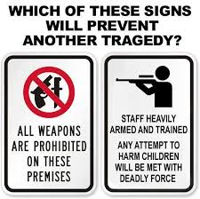
Preview
How do interest groups impact public policy?
Public Opinion: supply the public with information to build a positive image for a particular group
Propaganda: use persuasion to create a particular belief that may be true or false
Notes:
9

Slide 10
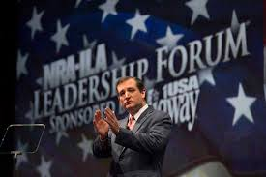
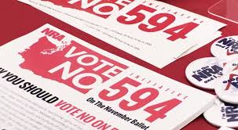
Preview
How do interest groups impact public policy?
Parties & Elections: secure the support of one or both of the major parties and provide campaign funds
Lobbying: apply pressure to legislators who consider passage of specific bills
Notes:
10

