Slide 1
The Enlightenment

Slide 2
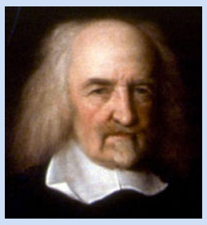
Thomas Hobbes
•King with absolute power is the best form of government
Believed people needed government to impose order
–People selfish, greedy
–Should exchange some freedoms for peace, safety, order

Slide 3
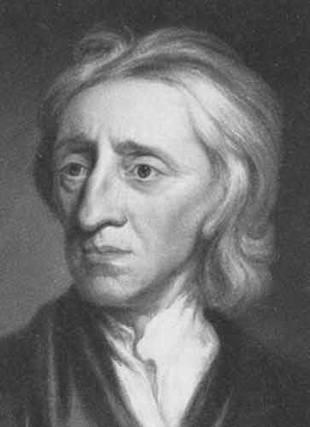
John Locke
•English philosopher, believed all people born equal
Natural rights
Life, Liberty, Property
Consent of the Governed
Governments power limited by laws

Slide 4
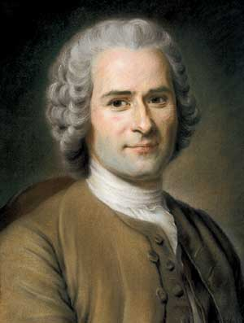
Jean-Jacques Rousseau
French philosopher, believed people basically good
•Believed people are born good but society corrupts them and can make them bad.
•Wrote The Social Contract, contract between all members of society

Slide 5
Jean-Jacques Rousseau
•Believed government should work for common good, not wealthy few
•Individuals should give up some freedoms for benefit of community
•Despised inequality in society

Slide 6
Baron de Montesquieu
Separation of powers
Best form of government divided power among branches of government
Separation of powers kept individual or group from abusing power

Slide 7
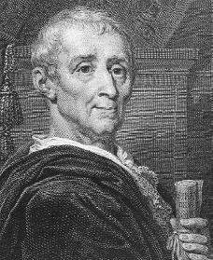
Baron de Montesquieu
•Powers divided into branches: legislative, executive, judicial
•Parliament made laws, king carried out laws, courts interpreted laws
•Separation of powers allowed each branch to check against power of others
•Concept later important structure of democratic governments

Slide 8
Some Enlightenment philosophers focused on government, others on issues in society

Slide 9
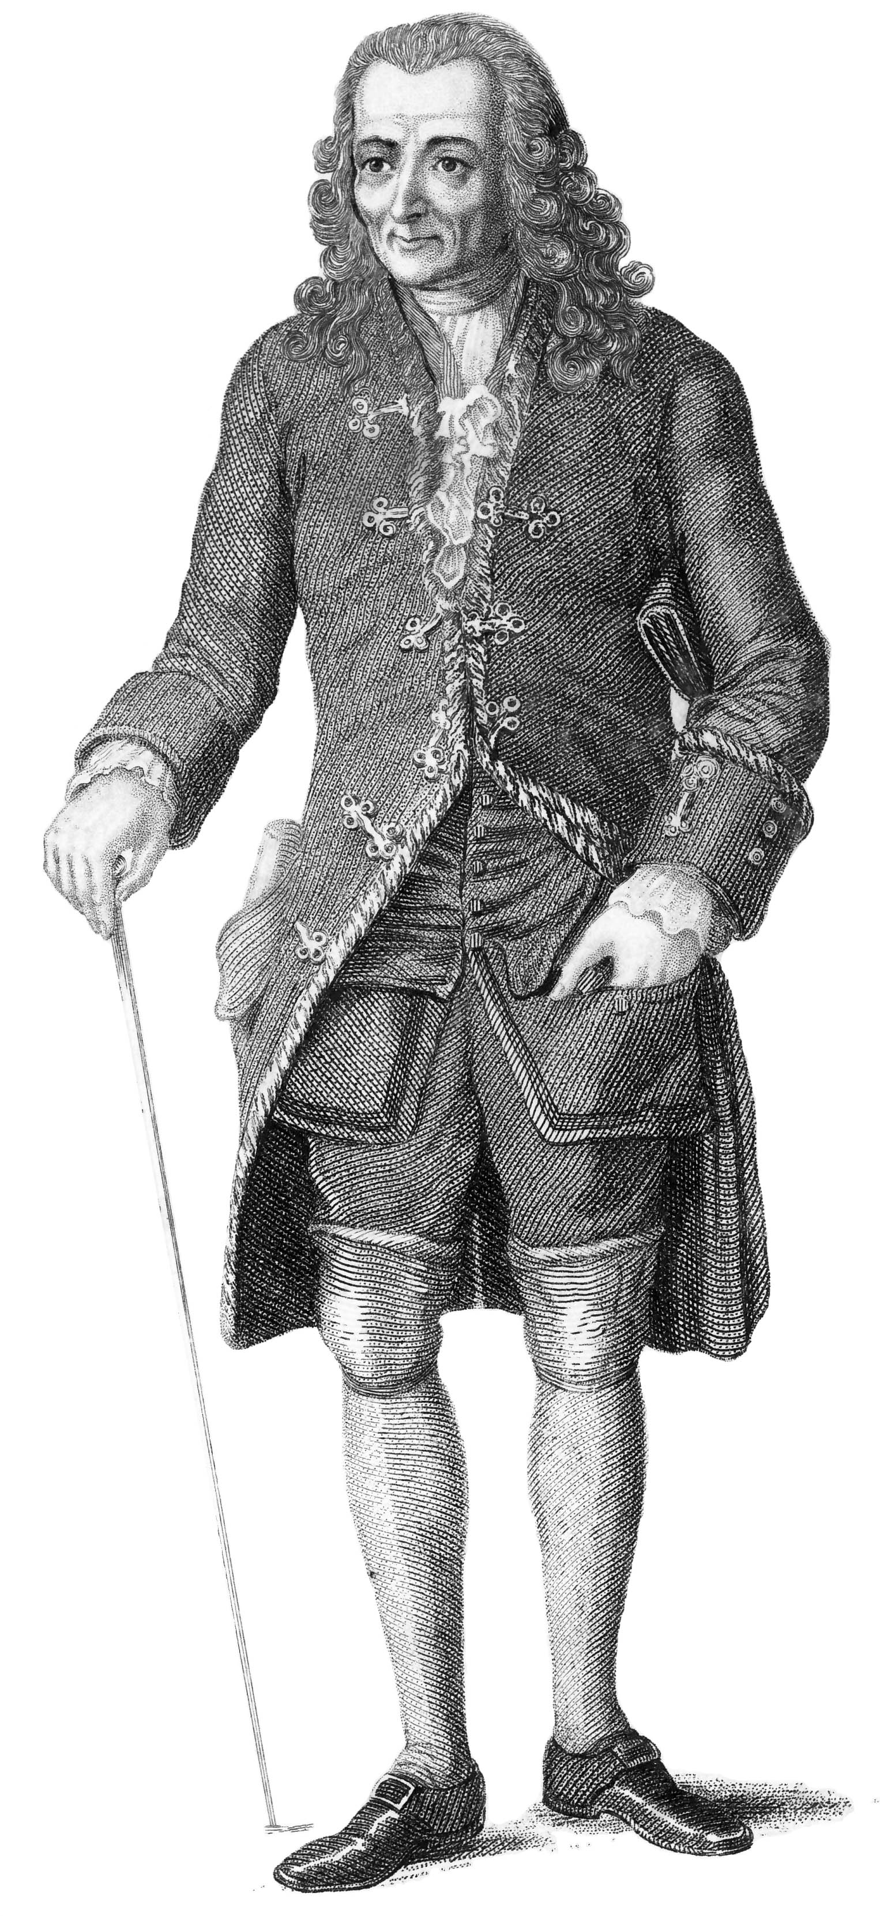
Voltaire
•Francois-Marie Arouet, wrote as Voltaire
•Outspoken philosopher, freedom of speech
–Attacked injustice among nobility, government, church
–Created enemies, imprisoned twice
- Believed in religious toleration and separation of church and state

Slide 10
Voltaire
–Exiled to England for two years
–Defended principles, fought superstition, ignorance
–Lifelong struggle for justice, toleration, liberty

Slide 11
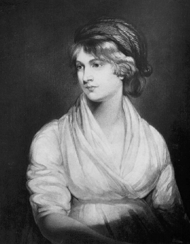
Mary Wollstonecraft
•Wollstonecraft demanded equal rights for women
•A Vindication of the Rights of Woman, equal education for women

Slide 12
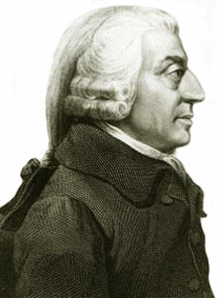
Adam Smith
•Scottish economist, used reason to analyze economic systems
•The Wealth of Nations advanced free market enterprise
•Strong believer in laissez-faire economics, no government regulation in the economy
•Believed economy would be stronger if business were left alone and allowed to compete with one another

Slide 13
Key Ideas of the Enlightenment
The ability to reason is what makes humans unique
Reason can be used to solve problems and improve people’s lives
Reason can free people from ignorance, superstition, and unfair government

